Slide 2
Microsoft Dynamics GP 2013, GP 2013 R2, and GP 2015: New feature highlights
CS15G009-R1
Alice Newsam
Senior Software Engineer
Daryl Anderson
Senior Program Manager
#Conv15

Slide 3
System

Slide 4
System
Microsoft Dynamics GP 2013 Service Pack 2 (SP2)
Document Attach 2.0:
Document Flow
Status Tracking
Delete Password
Attachment Properties
Attachment Email
Delete Utility

Slide 5
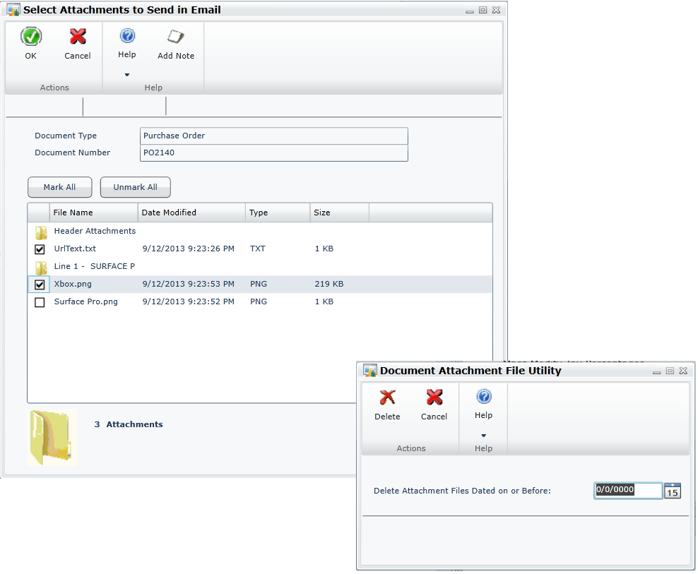
Document Attach 2.0
SP2
Ability to email attached documents along with a transaction
Mark attachments to flow from master record to transactions
Ability to mass delete attached files by date

Slide 6
System
Microsoft Dynamics GP 2013 R2
Identity Management
SmartList Designer 2.0
Take Company Offline
Azure Backup
Ribbons on desktop client
SQL Server Reporting Services (SSRS) on transaction forms
Document Attach 3.0:
Document Attach OLE Notes
OLE Note Migration
Payables Transaction Attach
Scan and Attach
Email and print documents together
Email by document type
Print or email reports in Word

Slide 7
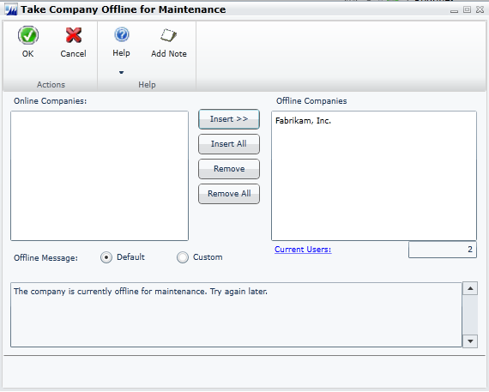
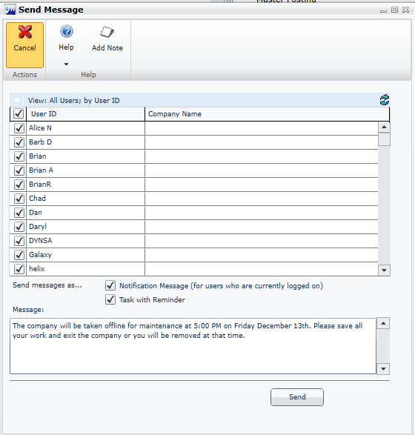
Take company offline
R2
Limit company access for maintenance
Assign user with access
Message users

Slide 8
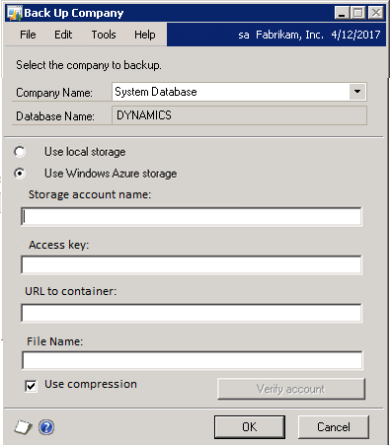
Azure backup
R2
Disaster recovery
Backup/restore directly to/from Azure Storage
Option in Microsoft Dynamics GP window

Slide 9
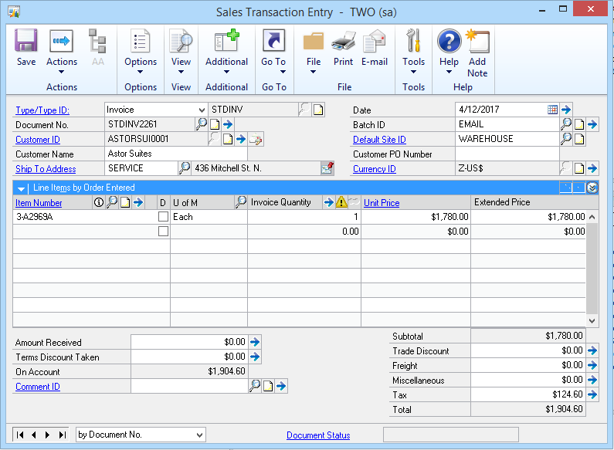
Ribbons on desktop
R2
Freshen desktop client UI
Include ribbons on all forms
Specified by user

Slide 10
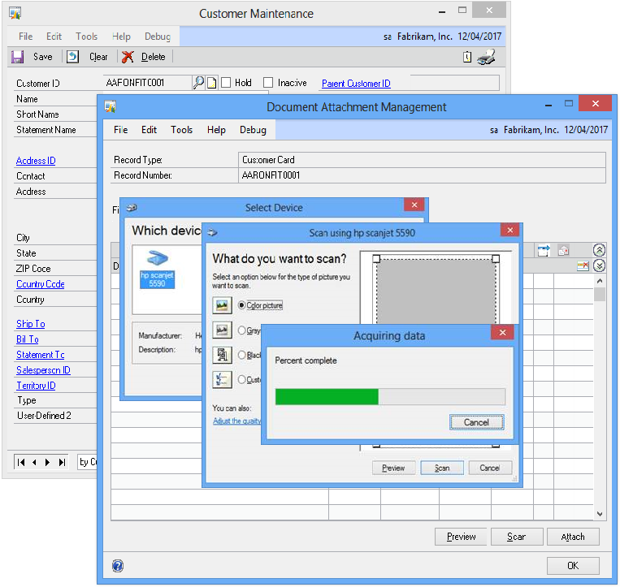
Document Attach 3.0
R2
Scan documents directly to Doc Attach from scanner
Add Doc Attach to payables
Convert OLE Notes to Doc Attach

Slide 11
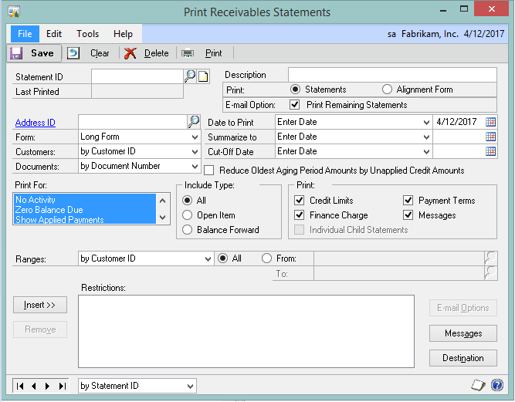
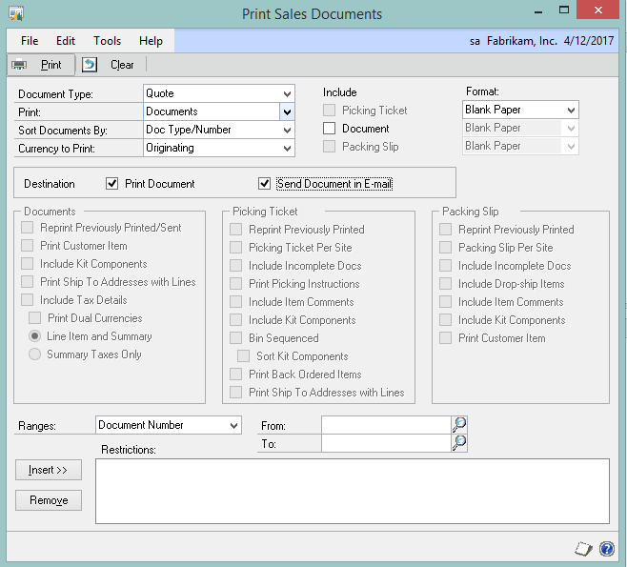
Email and print documents together
R2
Print and email in one step
Available for email batch process
Available for email statements process

Slide 12
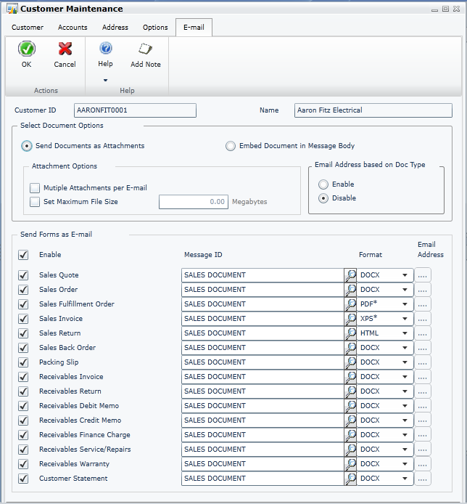
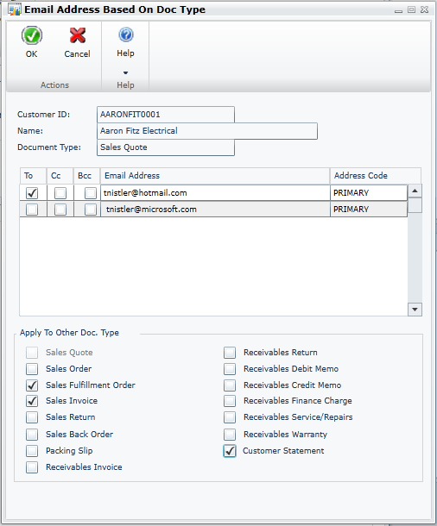
Email by document type
R2
Allow customers to email documents based on the specific document type
Can enable or disable the feature

Slide 13
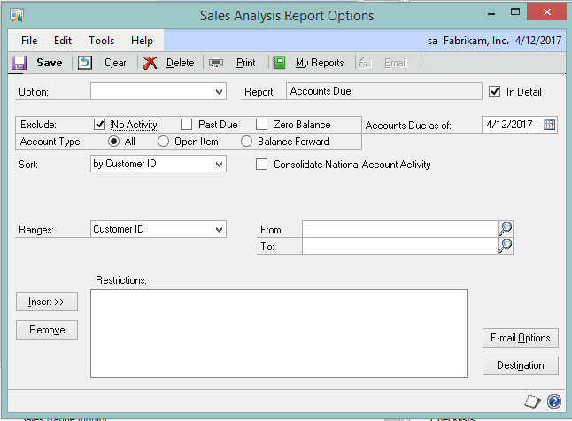
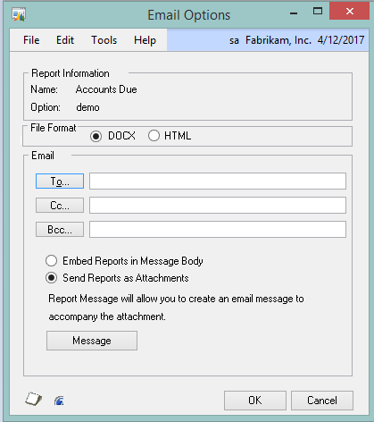
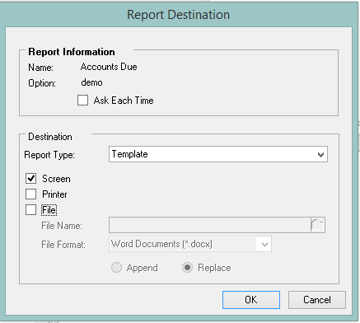
Print or email reports in Word
R2
Ability to send reports
in Word format
Ability to print reports as Word templates
Use Word tools to modify
the reports

Slide 14

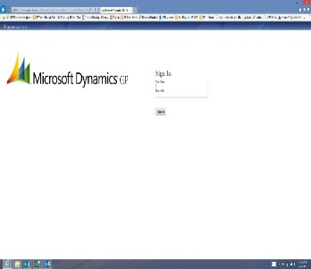
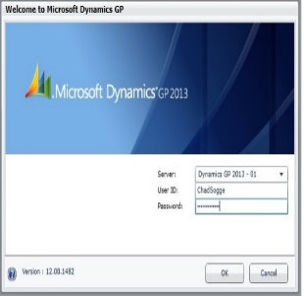
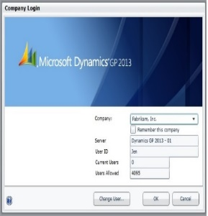
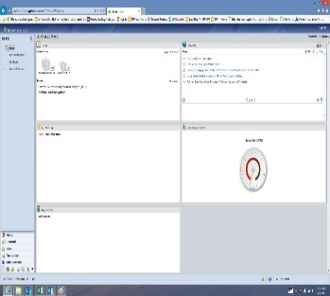
Identity management
R2
Log in to Microsoft Dynamics GP web client using a Windows account
Keep the user signed in to the website

Slide 15
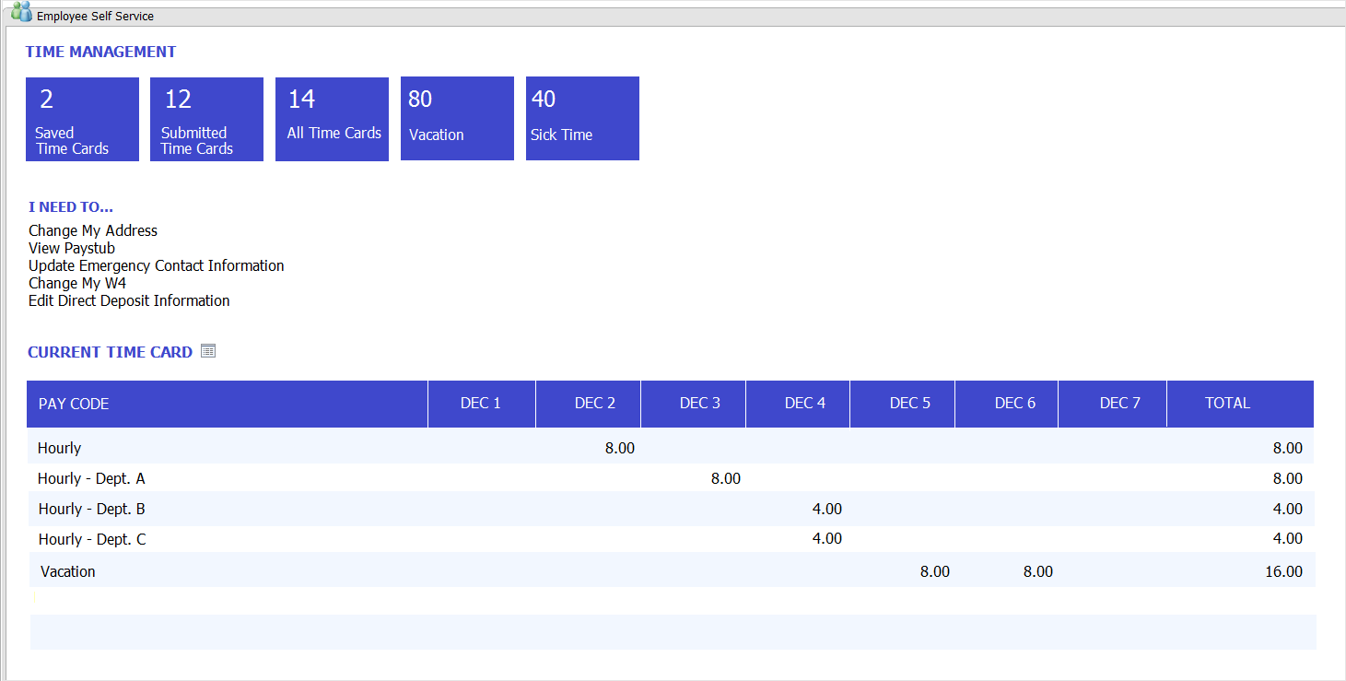
Self-service home page
R2
New home page content
Quick and simplified navigation
Preview important information

Slide 16
System
Microsoft Dynamics GP 2015
Service Based Architecture
Identity Management
SmartList Designer – refreshable Excel reports
Navigation integration for Microsoft Management Reporter
Copy home page settings
Management Reporter integration options

Slide 17







Acquire
65% of companies are deploying at least one social software tool
Service based architecture
2015
Scalable deployment
models fit any sized organization needs
GP consumes and exposes services
Logic in any dictionary including ISV products can be exposed as service operations
https://contoso.com/GPService/Tenants(DefaultTenant)Companies(contoso)/inventory/items(100XLG)
Secure access
Use Windows or Office 365 identity to authenticate
Enhanced interoperability gives developers additional capability to use the Microsoft platform
https protocol with REST style API lets you build apps on many different platforms
Discovery
operations
inform you of available operations and their syntax
Operation security
Managed within the Microsoft Dynamics GP application just like forms and reports
Integrate to other applications or services
Deployable on

Slide 18
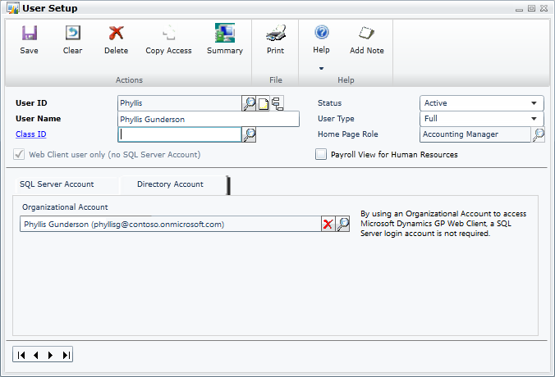

Identity management
2015
Log in to Microsoft Dynamics GP web client using Organizational Account credentials (Azure Active Directory [AD] account)

Slide 19
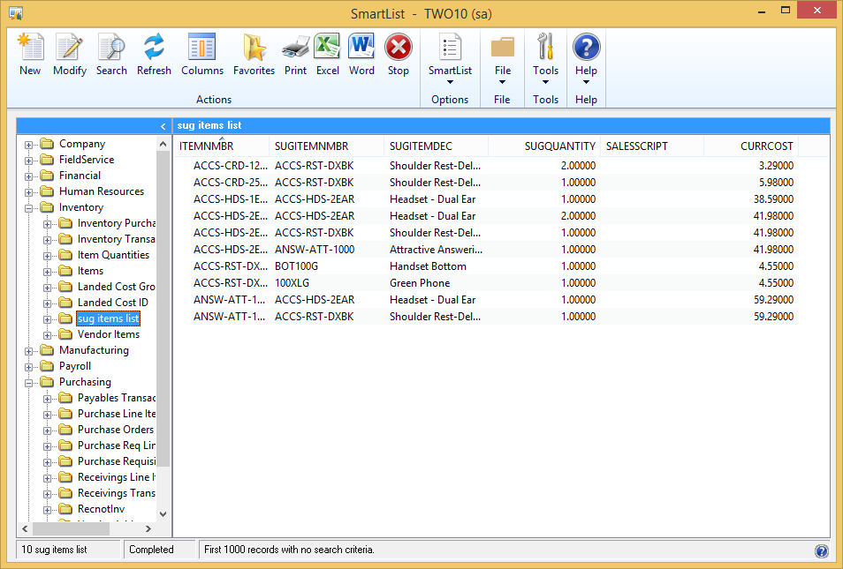
Refreshable Excel reports
2015
Continue to add new functionality
Enable tighter integration with Smartlist Designer and Excel

Slide 20
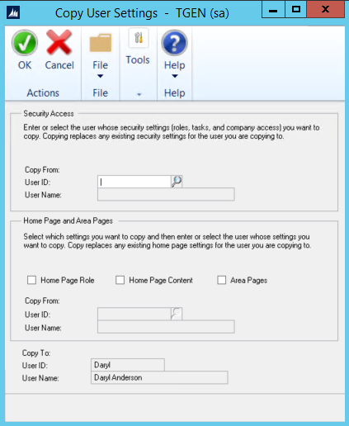
2015
Copy home page and area page
Copy home page settings and content to other users
Copy area page settings to other users

Slide 21
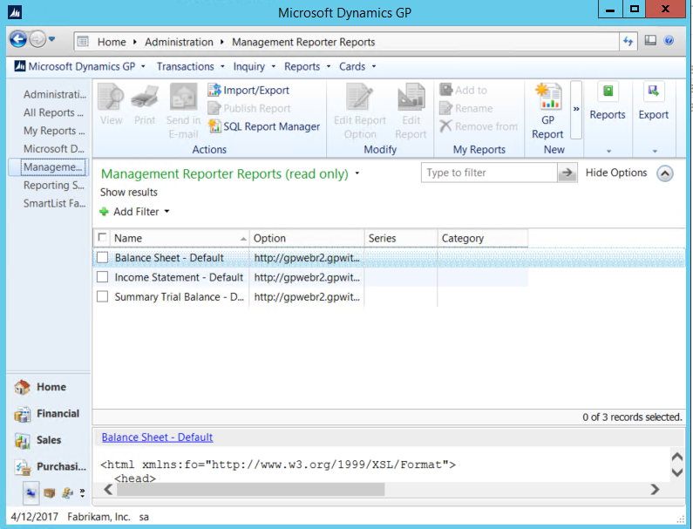
Navigation to Management Reporter
2015
New Navigation List
for Management
Reporter reports
View, Edit, and Create Management Reporter actions

Slide 22
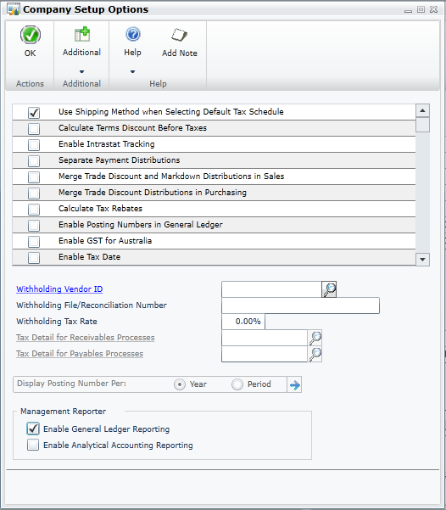
Management Reporter integration options
2015
In Company Setup Options, you control what data Management Reporter uses for General Ledger and/or Analytical Accounting reporting for each company

Slide 23
Sessions to learn more
DD15G103 – Microsoft Dynamics GP: Email and Microsoft Word Templates
When: Tuesday, March 17 3:30 PM - 5:00 PM
Type: Deep Dive
CS15G017 – Microsoft Dynamics GP 2015: Security
When: Tuesday, March 17 2:00 PM - 3:00 PM
Type: Concurrent Session
CS15G014 – Leveraging Microsoft Dynamics GP 2015: Service-based architecture for better integrations
When: Wednesday, March 18 2:00 PM - 3:00 PM
Type: Concurrent Session
CS15G004 – Microsoft Dynamics GP 2013 through Microsoft Dynamics GP 2015: System wide functionality and tools
When: Wednesday, March 18 11:00 AM - 12:00 PM
Type: Concurrent Session

Slide 24
Web client

Slide 25
Web client
Microsoft Dynamics GP 2013
SP1
Modules
Human Resources
US Payroll
Returns Management
Contract Management
Inventory Bill of Materials
Excel Based Budgeting
Field Level Security
ADP integration
Features
Lync integration
Autocomplete
Business Analyzer on Navigation Lists
Microsoft Dynamics GP 2013
SP2
Modules
Project Series
Manufacturing
Fixed Assets Enhancements
Service Call Management
Bank Activity Statements
Payment Document Management
Features
Keyboard shortcuts
Visual Studio Tools – V1
Same port for website and runtime service
Microsoft Dynamics GP 2015
Invoicing
Canadian Payroll

Slide 26
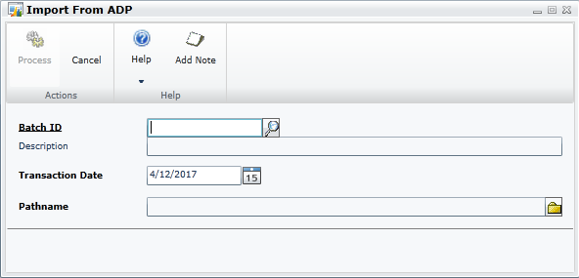
ADP integration to GL for web client
SP1
Import ADP transaction directly from the web client

Slide 27
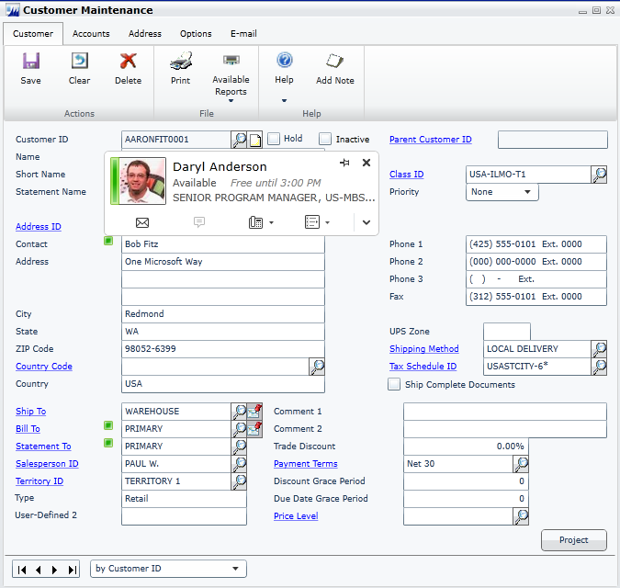
Web client Lync integration
SP1
Display presence
Initiate communication
Configure computer from web client

Slide 28
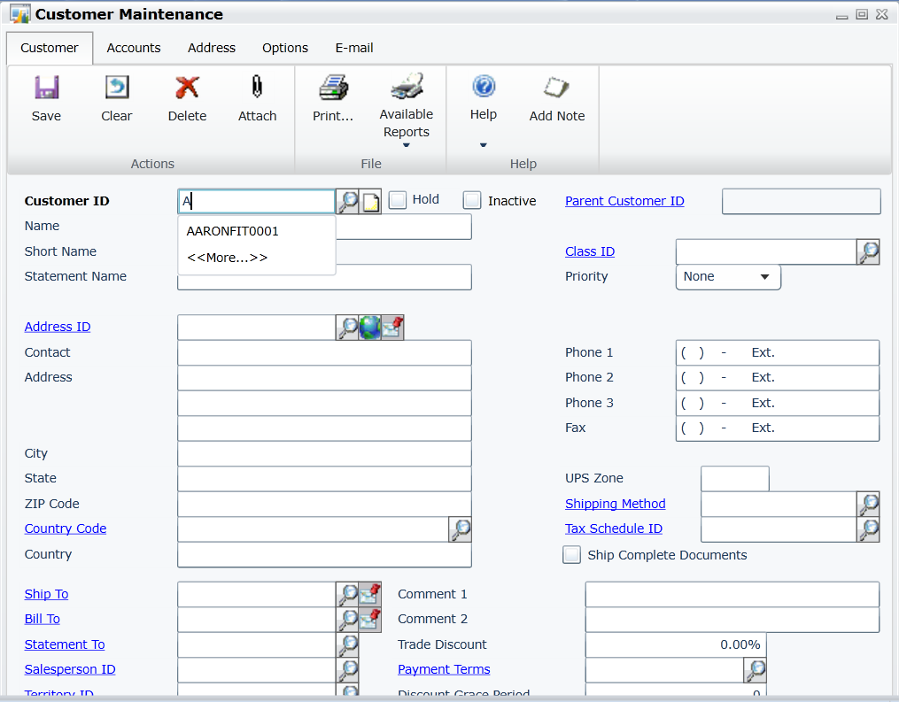
Autocomplete in web client
SP1
Provides list of previous entries to field
Captures lookup field values
Stored locally same as desktop client

Slide 29
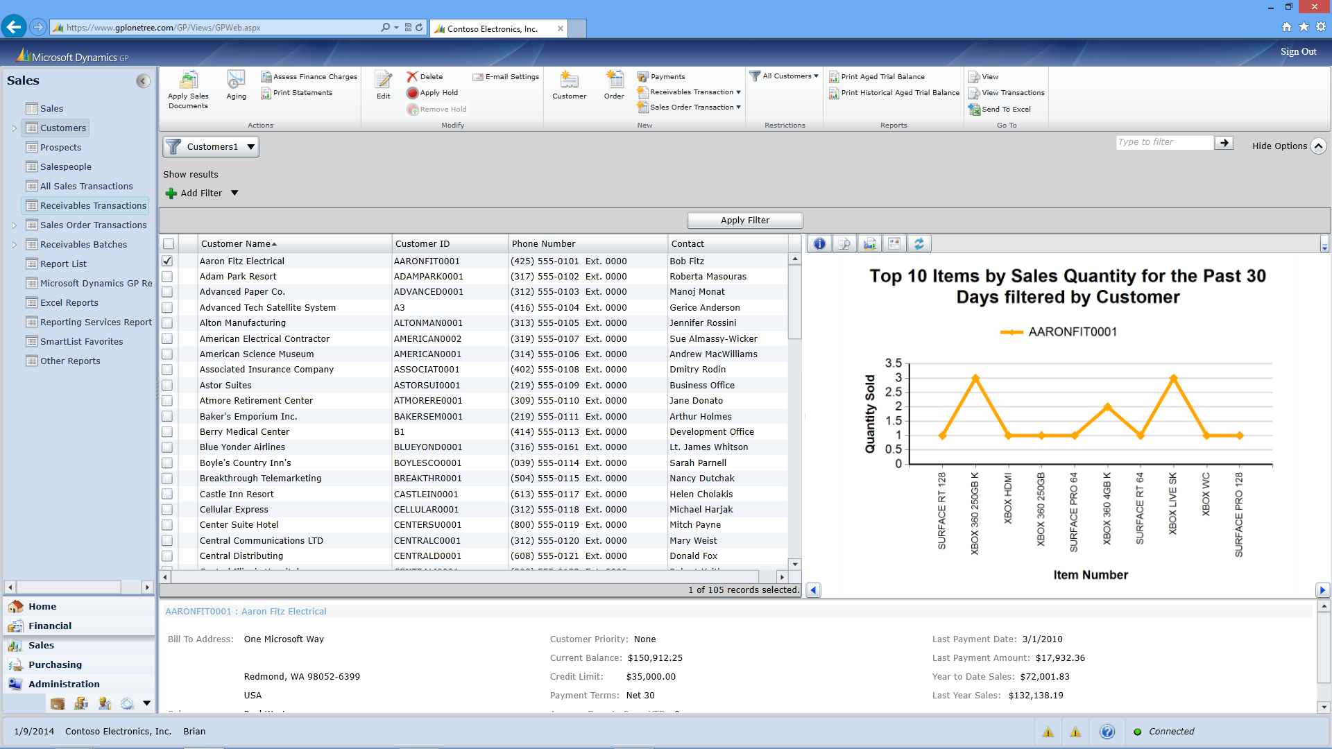
Business analyzer navigation lists for web client
SP2
Graphical representation of list data
Customizable
Utilizes SQL Server Reporting Services (SSRS)
Actionable

Slide 30
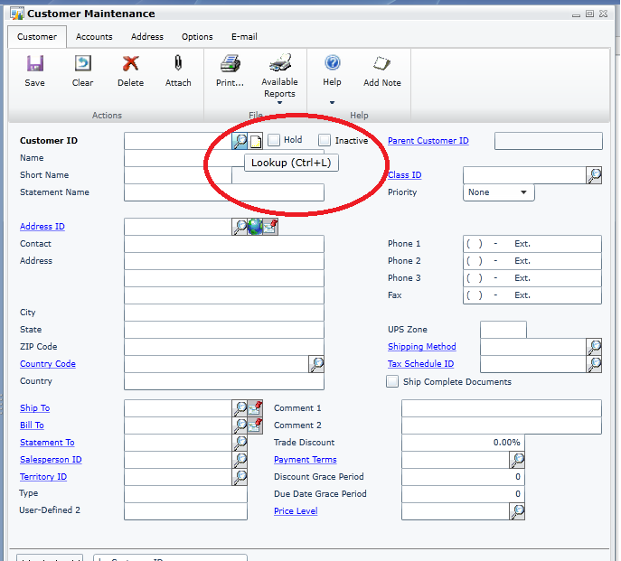
Keyboard shortcuts for web client
SP2
Uses familiar character keys
Added Alt key to combination to work with browser (Ctrl + L is now Ctrl + Alt + L)

Slide 31
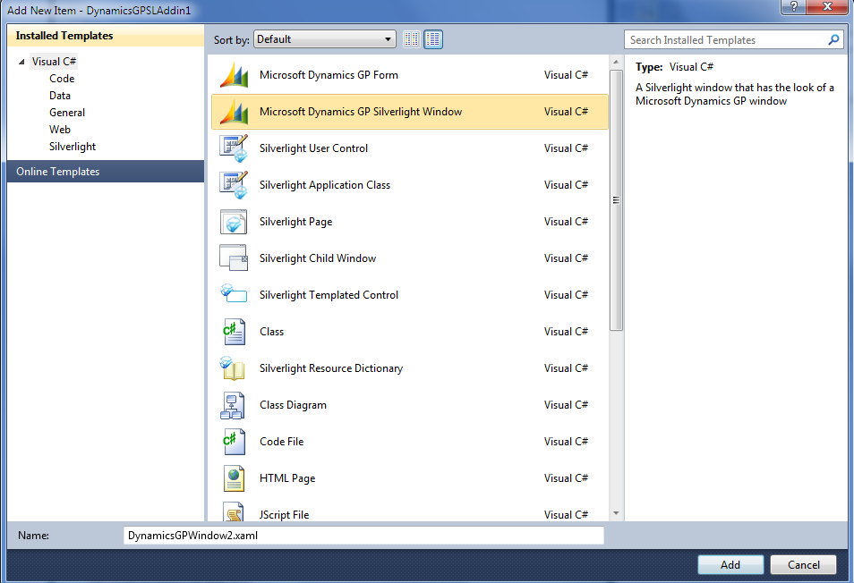
ISV extensibility for web client
SP2
Use Visual Studio Tools windows
Two rendering models
    Dynamic (uses simple controls)
    Custom – use any control or advanced client side interactions

Slide 32
Session to learn more
CS15G019 – Microsoft Dynamics GP Web Client and Desktop Client: Mixed Deployment
When: Wednesday, March 18 3:30 PM - 4:30 PM
Type: Concurrent Session

Slide 33
Business intelligence

Slide 34
Business intelligence
Microsoft Dynamics GP 2013 SP2
Business Analyzer Release 5
HTML5/JavaScript
Companion Application Service
Business Analyzer Window Phone 8 Release
SmartList Designer 2.0
SmartList UI enhancements
Microsoft Dynamics GP 2013 R2
Business Analyzer Release 6
Excel Content
SmartList Designer 2.0
Encumbrance Summary SSRS Report
Print or email Word forms
Microsoft Dynamics GP Workspace
Microsoft Dynamics GP 2015
Business Analyzer R7
Windows 8
iOS
Android
Management Reporter content
Management Reporter Navigation integration
Refreshable Excel reports created from SmartList Designer

Slide 35
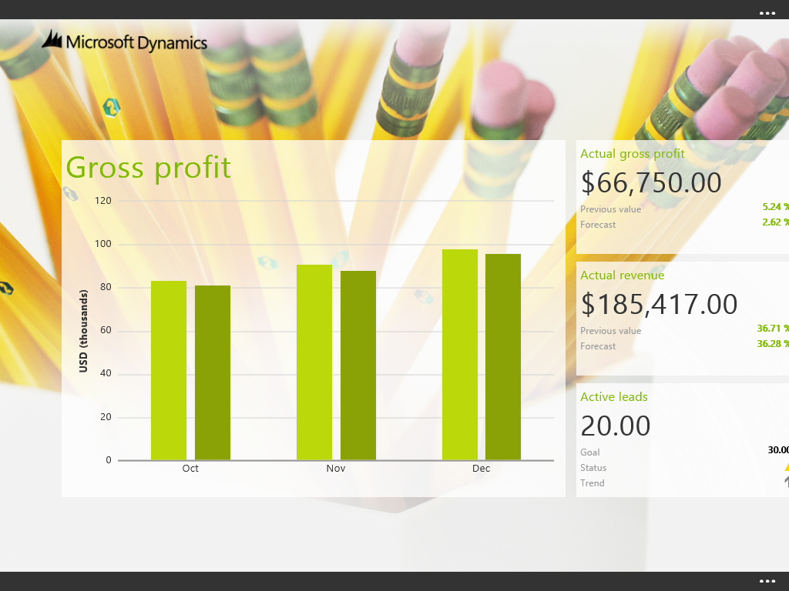
Business Analyzer R5
HTML5/Java Script UI refresh
Windows 8 design

Slide 36
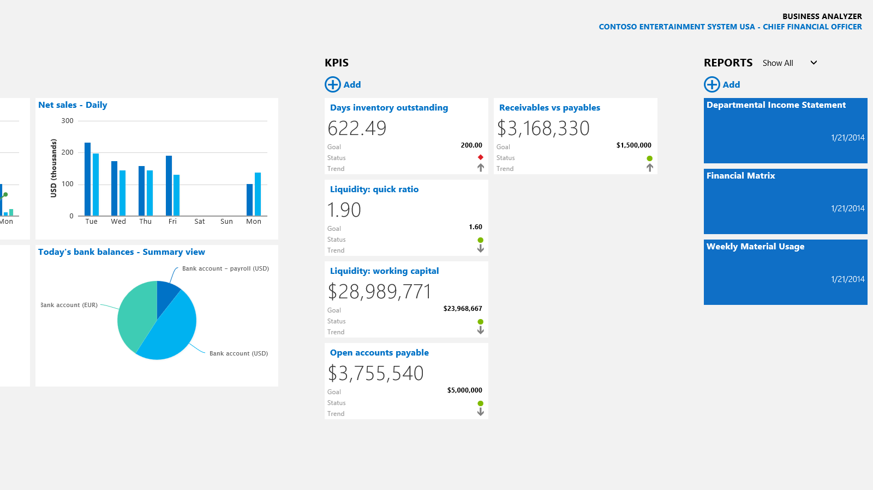
Business Analyzer R6
Supports Excel content within the app

Slide 37
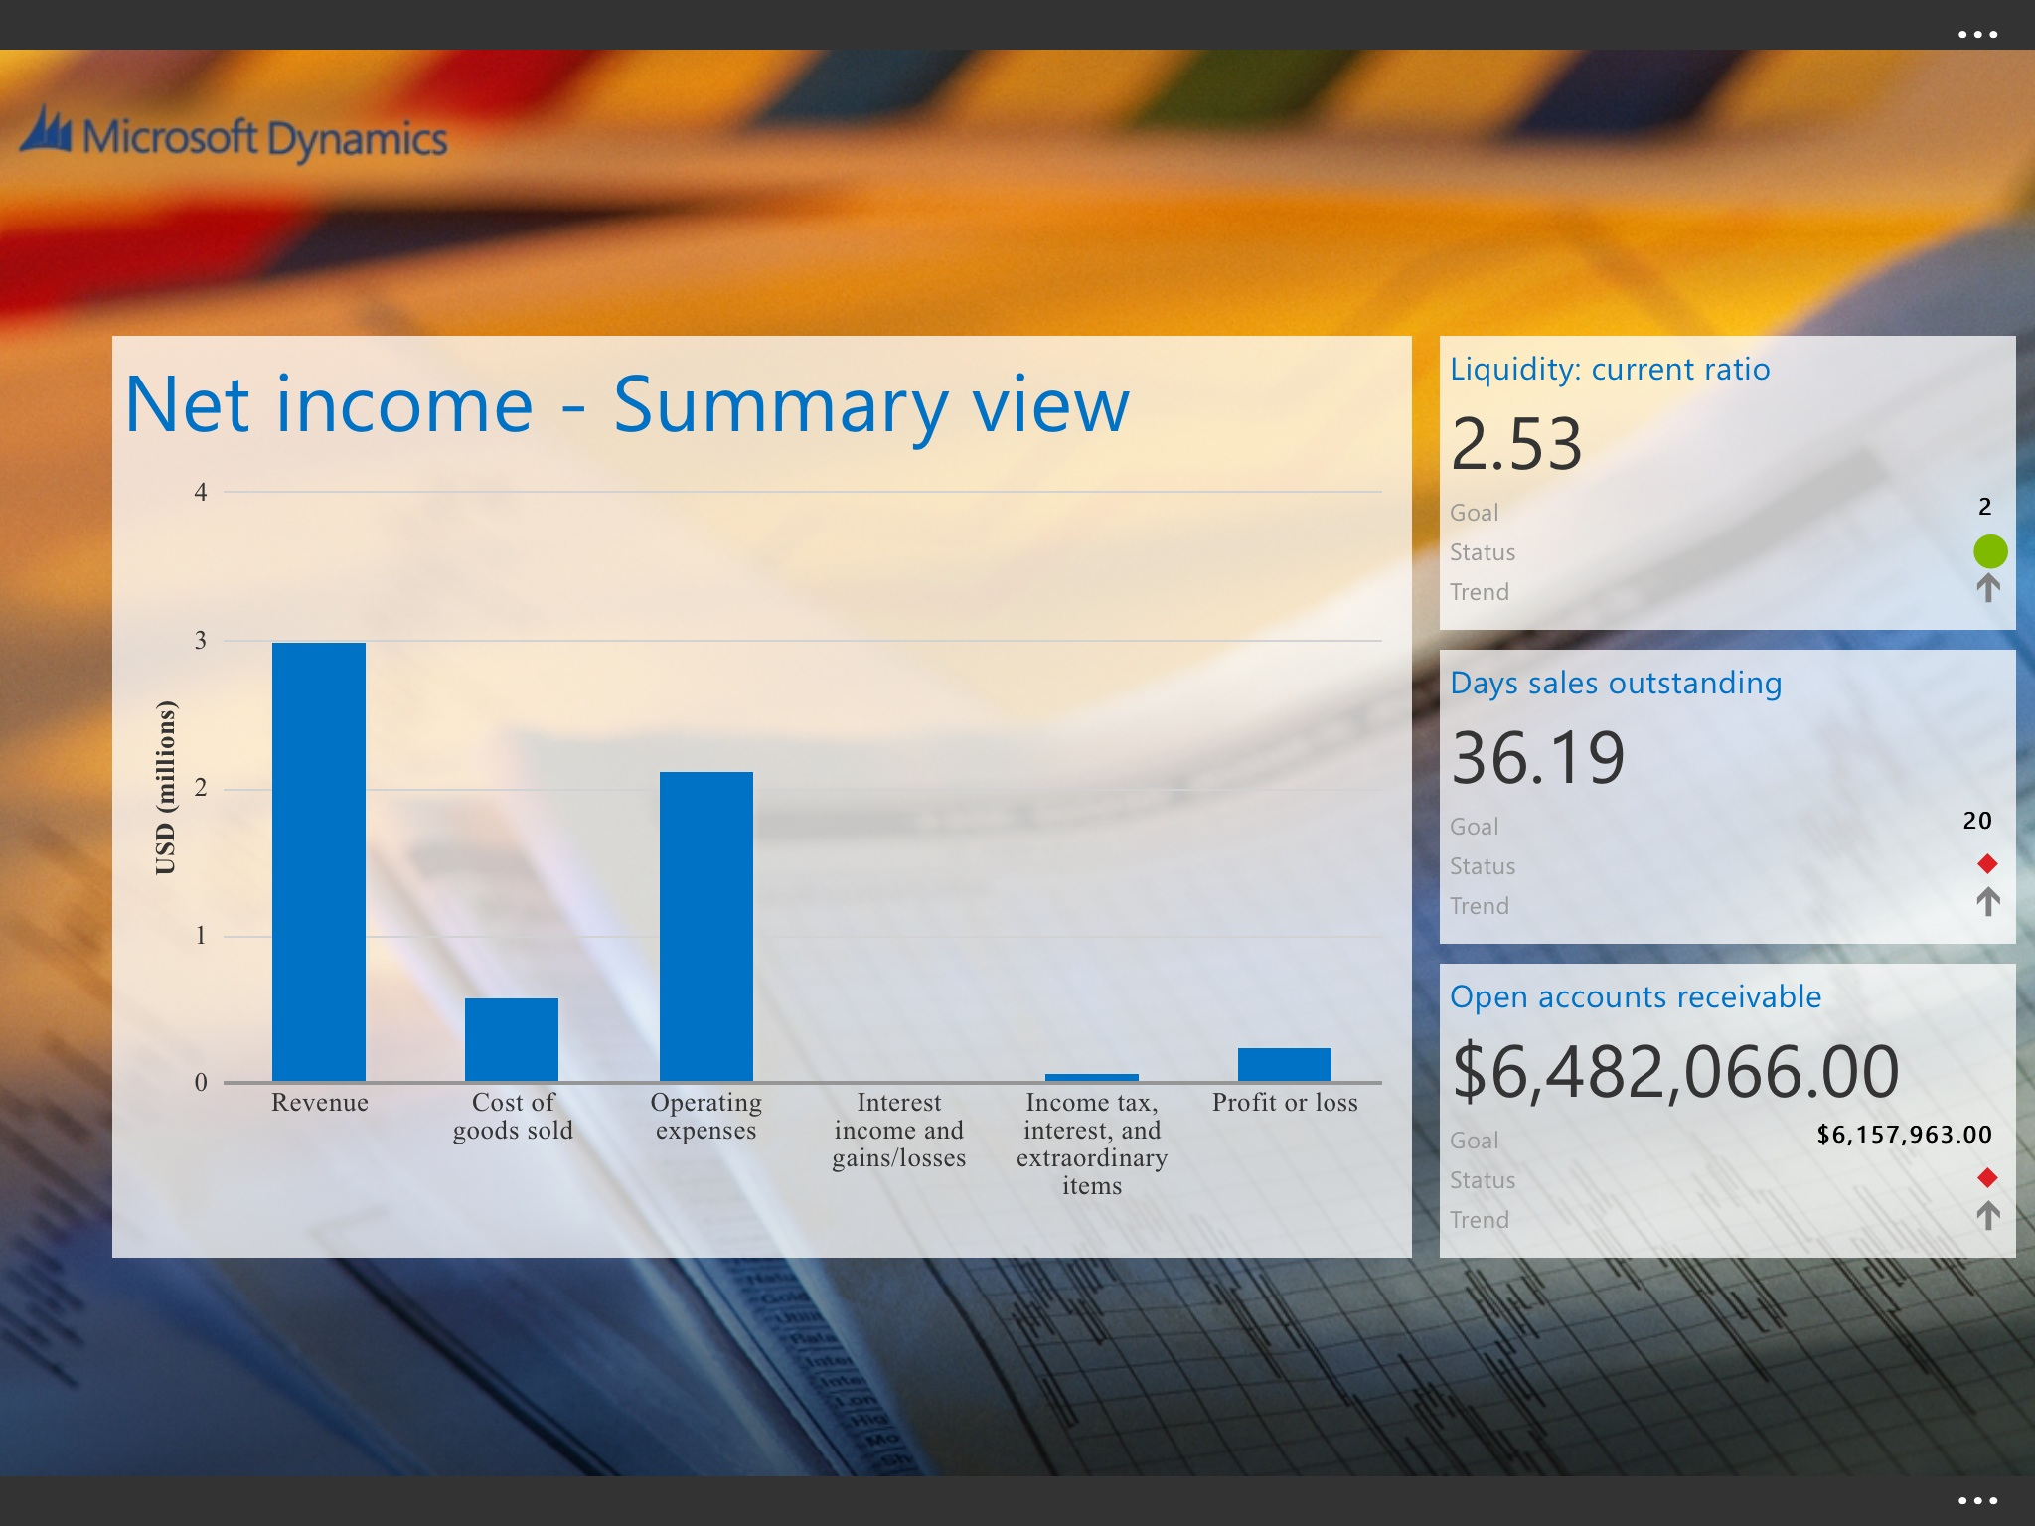



Business Analyzer Release 7
2015
Cross platform
Content management improvements
Support for Management Reporter content

Slide 38
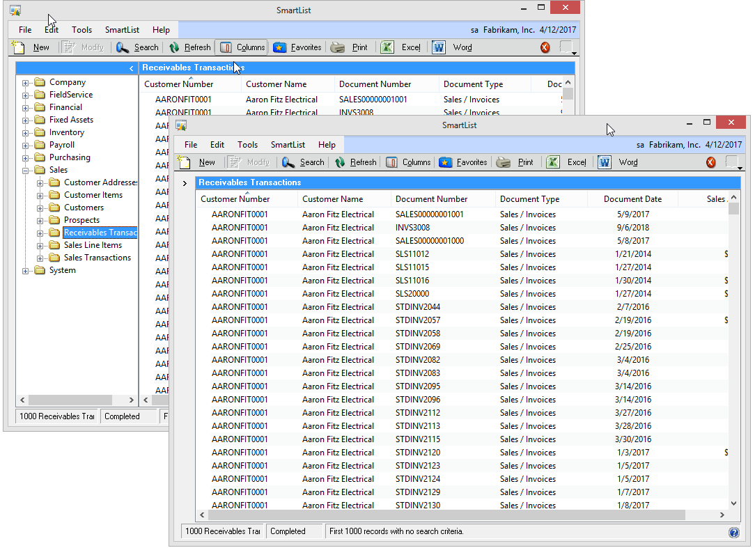
SmartList UI enhancements
SP2
Hide or auto-hide
Favorites pane
Change width of
Favorites pane
Remember settings

Slide 39
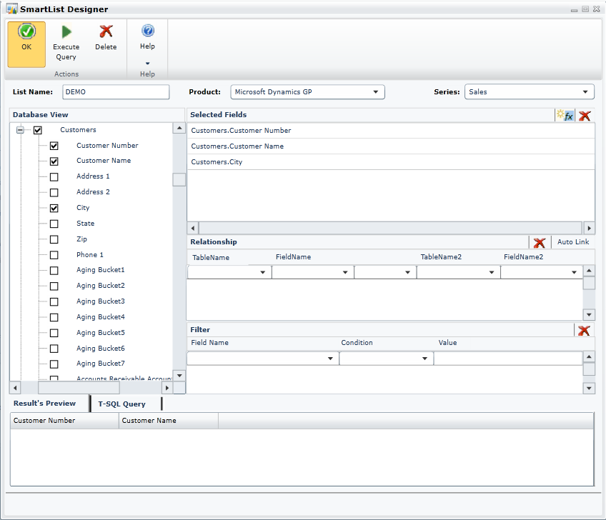
SmartList Designer
SP2
Create or modify existing SmartLists
Select and join data from tables or views
Easy-to-use interface

Slide 40
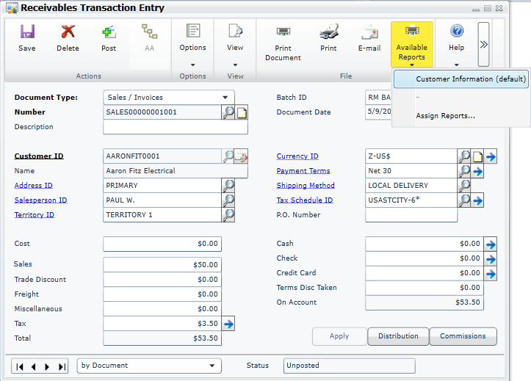
SSRS on transaction windows
R2
Extend the SSRS printing functionality allowing a user to print reports from transaction forms
Series include: Sales, Purchasing, Financial, Inventory, Payroll, Field Service, Project, and Manufacturing

Slide 41
Refreshable Excel reports
2015
Continue to add new functionality
Allow tighter integration with SmartList Designer and Excel

Slide 42
Sessions to learn more
DD15G107 – Data! Making sense of your Microsoft Dynamics GP data using Excel and Power BI
When: Tuesday, March 17 3:30 PM - 5:00 PM
Repeat: Wednesday, March 18 9:00 AM – 10:30 AM
Type: Deep Dive
CS15G001 – Microsoft Dynamics GP apps: Business Analyzer and Time Management
When: Monday, March 16 5:00 PM - 6:00 PM
When: Wednesday, March 18 3:30 PM - 4:30 PM
Type: Concurrent Session
CS15G007 – Building dashboards with Microsoft Dynamics GP and Microsoft Excel
When: Wednesday, March 18 3:30 PM - 4:30 PM
Type: Concurrent Session
ID15G004 – Microsoft Dynamics GP: Getting and sharing data
When: Wednesday, March 18 3:30 PM - 4:30 PM
Type: Interactive Discussion

Slide 43
Workflow

Slide 44
Workflow
Microsoft Dynamics GP 2013 R2
Purchasing
Purchase Order Approval
  Purchase Requisition Approval
Payroll
  Timecard Approval
Project
  Timesheet Approval
Microsoft Dynamics GP 2015
Financial
  General Ledger Batch Approval
Purchasing
  Payables Batch Approval
  Vendor Approval
Sales
  Receivables Batch Approval
Payroll
  Employee Skills Approval
  Direct Deposit Approval
  Employee Profile Approval
  W4 Approval
Project
  Expense Report Approval

Slide 45
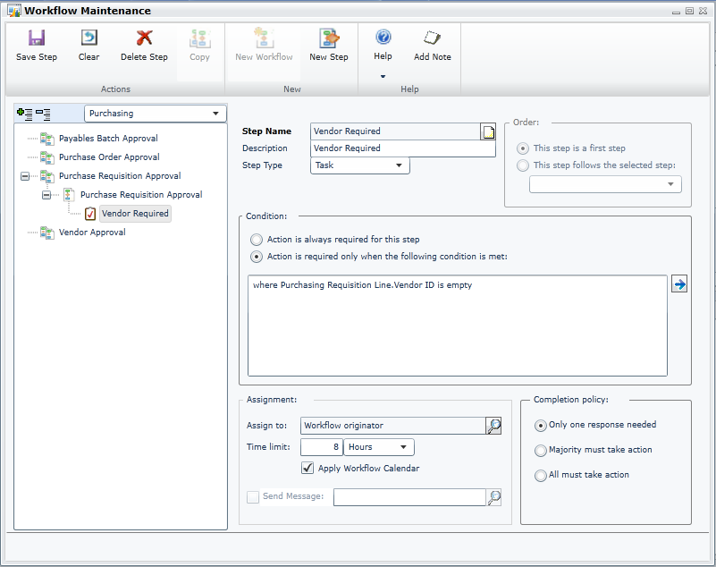
Workflow maintenance
R2
Setup workflow in Microsoft Dynamics GP 2013 GP
Define approval or task steps for your business process
Use AD users/groups/hierarchy or Workflow Roles to assign steps
Use Active Directory hierarchy for manager routing

Slide 46
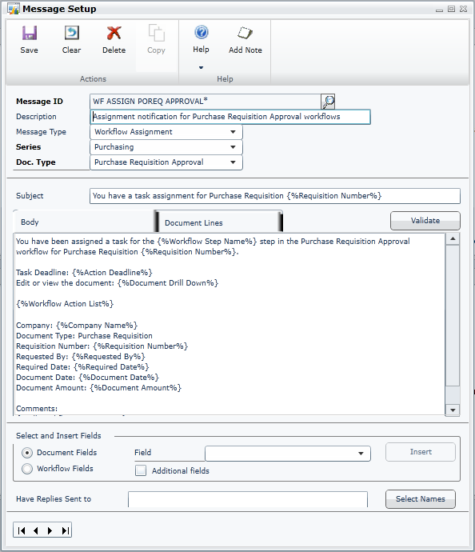
Workflow notifications
R2
Action assignment and action completed notifications
Notifications via Microsoft Dynamics GP 2013 GP transaction window, navigation list, home page, and email
Unique approver messages for workflow

Slide 47
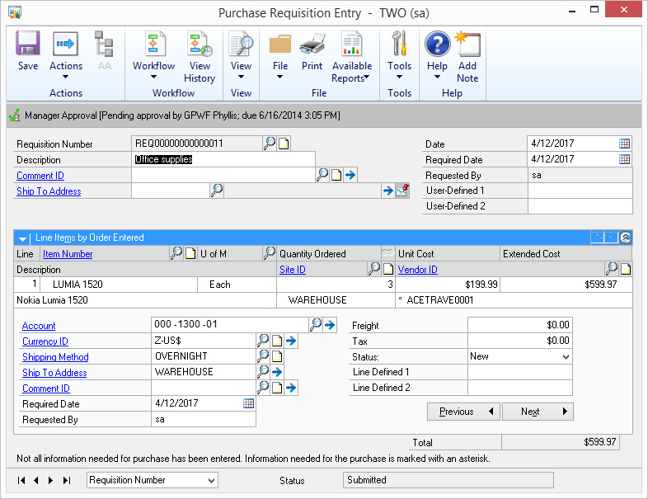
Workflow approval
R2
Approval actions using Microsoft Dynamics GP transaction window, navigation lists, and email
Out-of-office delegations
Perform automatic action on overdue tasks

Slide 48
Session to learn more
CS15G027 – Microsoft Dynamics GP Workflow Unplugged
When: Wednesday, March 18 2:00 PM - 3:00 PM
When: Thursday, March 19 3:30 PM - 4:30 PM
Type: Concurrent Session

Slide 49
Financials

Slide 50
Financials
Microsoft Dynamics GP 2013 SP2
Display Checkbook ID on Cash Receipts Inquiry
Customer Combiner and Modifier
Vendor Combiner and Modifier
Payables Void enhancements
Reconcile Checkbook without Marking Transaction
AA Finance Charge Assessment
AA and Sales Order deposits
Microsoft Dynamics GP 2013 R2
Copy and Paste to GL
Roll Down Account Segment Description
Reverse Fiscal Year
Reprint Outstanding Transactions report
Default sort order for Payables Checks
Payables Transaction Document Attach
Default Asset ID from Fixed Asset Class
Integrate Multicurrency Revaluation with AA
Microsoft Dynamics GP 2015
Intercompany enhancements
Payables Warning when open Purchase Order
Payment Terms Enhancements
Fixes Assets Year End Close report
Edit email for Historical Statements and Payables Remittance
General Ledger Batch Workflow
Payables Batch Workflow
Vendor Approval Workflow
Receivables Batch Workflow

Slide 51
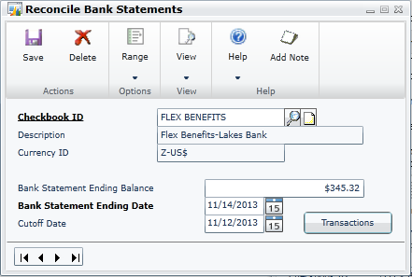
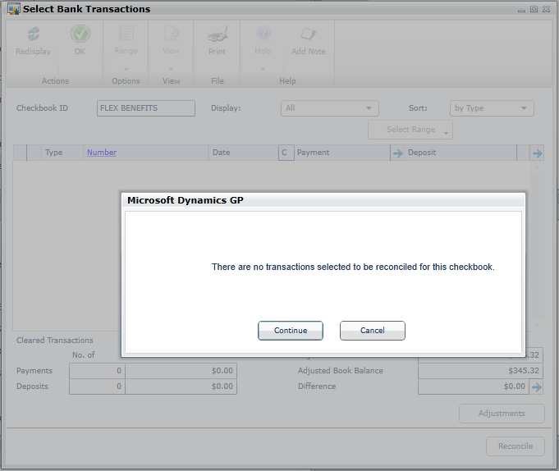
Reconcile checkbook without marking
SP2
Reconcile without marking transactions
Maintain audit trail for inactive checkbooks

Slide 52
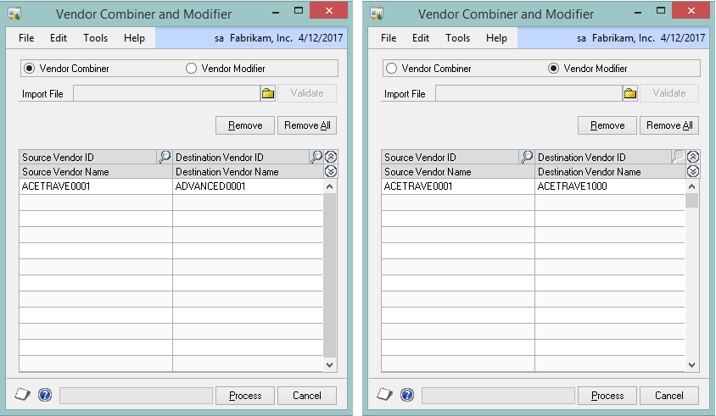
Vendor combiner and modifier
SP2
Combine Existing Vendor ID with another Vendor ID
Update Existing Vendor ID with new ID
Vendor ID will update for all existing records

Slide 53
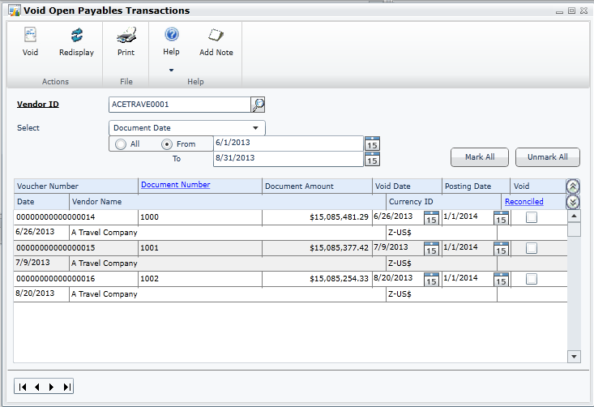
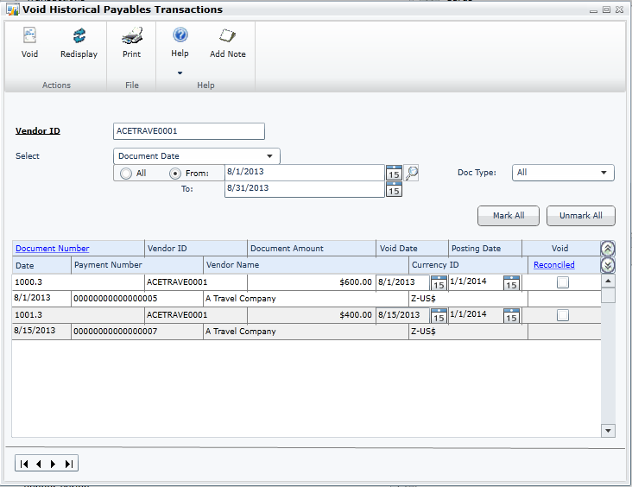
Void payables transaction updates
SP2
Void Open transactions
Restrict by Date
Restrict by Document Number
Void Historical transactions
Restrict by Vendor
Restrict by Date
Restrict by Document Number
Browse Vendors

Slide 54
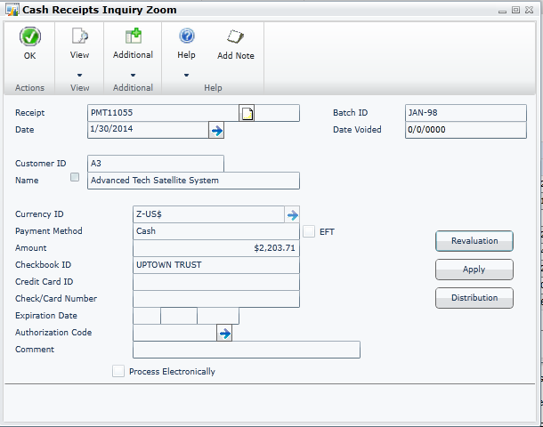
Checkbook ID on pmt inquiry window
SP2
Display Checkbook on inquiry for payments

Slide 55
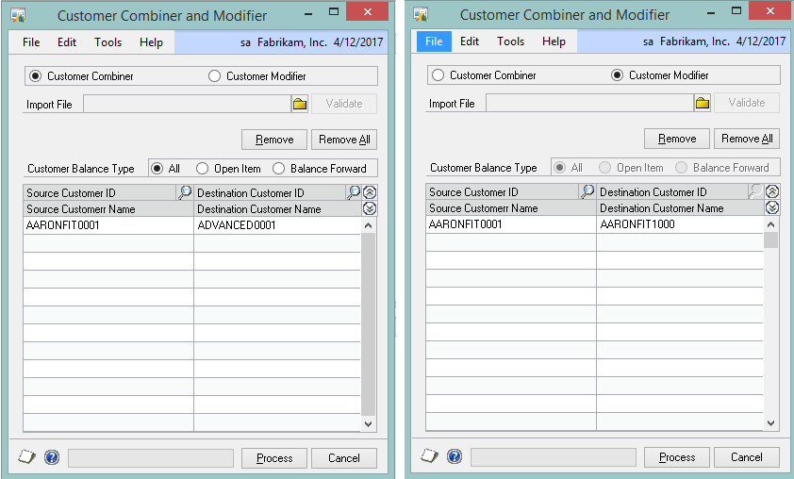
Customer combiner and modifier
SP2
Combine Existing Customer ID with
another Customer ID
Update Existing Customer ID with new ID
Customer ID will update for all existing records

Slide 56
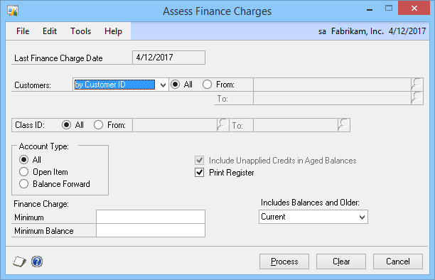
AA finance charge assessment
SP2
Analytical Accounting (AA) codes may be added to finance charge transactions

Slide 57
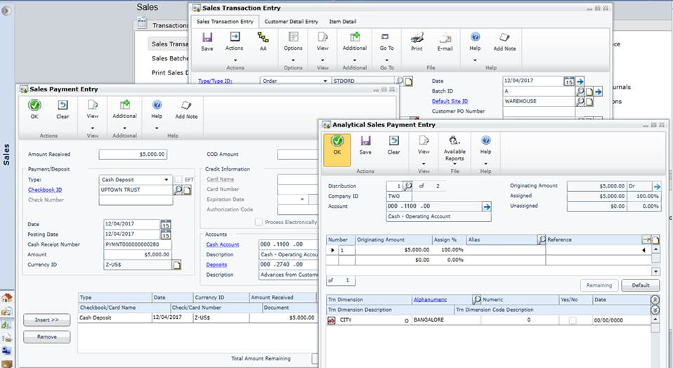
AA and sales order deposits
SP2
AA codes can now be added to Sales Order Deposits

Slide 58
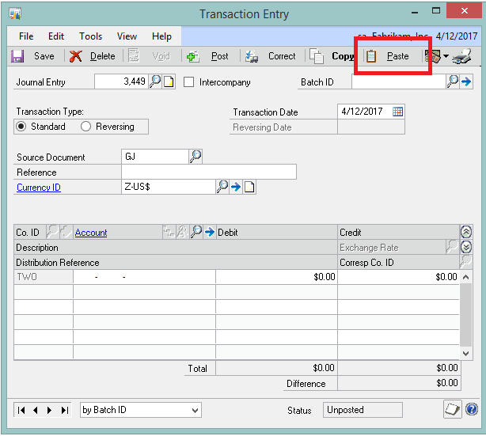
Copy and paste to GL
R2
Ability to paste from Excel to General Ledger (GL)
Will validate the data that is being pasted into the Transaction Entry

Slide 59
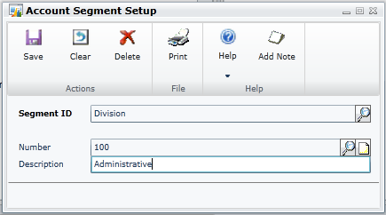
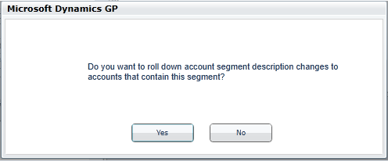
Roll down segment description
R2
Option to roll down description change to associated accounts

Slide 60

Reverse fiscal year
R2
Ability to reverse the GL Year-End Close process
Will open the previously closed fiscal year
Will warn users to create backups and verify all users out of Microsoft Dynamics GP prior to process

Slide 61

Reprint outstanding transactions report
R2
Reprint Outstanding Transactions report
Print Posting report after posting

Slide 62


Payables transaction doc attach
R2
Now you can attach documents in Payables Transaction Entry

Slide 63

Default sort order for checks
R2
Sort Checks By option will be found in the Payables Management setup
Sort options: Payment Number, Name, State-City, or Zip Code
Time-saving feature

Slide 64

Default asset ID from asset class
R2
New option for Fixed Asset IDs
More quickly set up asset records

Slide 65

Integration of multicurrency revaluation with AA
R2
Multicurrency Revaluation now linked with AA
AA codes on the original transaction can now be updated per the revaluation process

Slide 66

Intercompany enhancements
2015
Intercompany Journal Entry Inquiry
Void Intercompany Transactions

Slide 67

Payables warning when open PO
2015
New warning message added when entering a payables transaction for a vendor with an outstanding PO or un-invoiced receipt

Slide 68

Payment terms enhancements
2015
Due Date Option using
Transaction Date
Add Days to Due Date
Additional Due Options
Additional Discount Options
Options: Next Month, Months, Month/Day, and Annual

Slide 69

Edit email for historical documents
2015
Email historical Payables remittances
Edit email for historical remittances
Edit email for historical Receivables Statements

Slide 70

Fixed assets year end close report
2015
View annual summary information on close

Slide 71
Sessions to learn more
ID15G001 – Ask the experts: Financials for Microsoft Dynamics GP
When: Monday, March 16 5:00 PM - 6:00 PM
When: Wednesday, March 18 3:30 PM - 4:30 PM
Type: Interactive Discussion
CS15G010 – Microsoft Dynamics GP 2013 through Microsoft Dynamics GP 2015: Financials
When: Wednesday, March 18 2:00 PM - 3:00 PM
Type: Concurrent Session
Check out the Dynamics GP Financials Expo Booth as well!

Slide 72
Distribution

Slide 73
Distribution
Microsoft Dynamics GP
2013 R2
Suggested Item enhancements
Assign Item to multiple sites
Purchase Requisitions
Purchase Requisition Workflow
Purchase Order Workflow
Prepayment additions
Encumbrance SSRS reports
Project Time
Project Time Workflow
Microsoft Dynamics GP 2015
Edit email for historical documents – Sales and Purchasing
Payables warn when open Purchase Order
Payment Terms enhancements
Invoicing on web client

Slide 74

Suggested item enhancements
R2
Sales script for each item
Analyze option to suggest quantities
New fields: Price, Qty Available, Site ID

Slide 75

Assign Item to multiple sites
R2
Assign an Item to
multiple sites
Available from
Site Maintenance

Slide 76

Purchase requisitions
R2
Order items and goods
Combine requisitions to a single PO
Requisition workflow

Slide 77

Prepayment additions
R2
Integrate with Analytical Accounting, Multi Dimensional Analysis, Cash Flow Management, and Project Accounting
Show PO Number in Check Inquiry

Slide 78

Encumbrance SSRS reports
R2
SSRS reports that display Encumbrance data
Summary and Detail reports
Enable Print SSRS reports from Encumbrance forms

Slide 79

Project timesheet
R2
Employee self-service user can enter timesheets for projects he has worked on
Documents go through Workflow Approvals

Slide 80
Payment terms enhancements
2015
Due Date Option using
Transaction Date
Add Days to Due Date
Additional Due Options
Additional Discount Options
Options: Next Month, Months, Month/Day, and Annual

Slide 81
Edit email for historical documents
2015
Edit email for historical Sales documents
Edit email for historical Purchase Orders
Edit email for RM Statements
Email historical Payables Management PM Remittances
Edit email for PM Remittances

Slide 82
Payables warning when open PO
2015
New warning message
added when entering a payables transaction for a vendor with an outstanding PO or un-invoiced receipt

Slide 83

Project expense report
2015
Self-service user can enter expenses against a project to which they have been assigned and submit for approval through Workflow

Slide 84
Session to learn more
CS15G013 – Microsoft Dynamics GP 2013 through Microsoft Dynamics GP 2015: Distribution
When: Tuesday, March 17 2:00 PM - 3:00 PM
When: Wednesday, March 18 2:00 PM - 3:00 PM
Type: Concurrent Session
Check out the Microsoft Dynamics GP Distribution Expo Booth as well!

Slide 85
HR and Payroll
Employee Self Service

Slide 86
Payroll, PTO manager, and human resources
Microsoft Dynamics GP 2013 SP2
Applicant Email Address
Payroll Inquiry Check Date Sort
Microsoft Dynamics GP 2013 R2
Employee Time Management
Time on Behalf of
Timecard Workflow
Microsoft Dynamics GP 2015
Employee Self Service:
Employee Profile
Employee Profile Workflow
Manager Team Profile
Employee Paystubs
W4
W4 Workflow
Employee Benefits
Direct Deposit
Direct Deposit Workflow
Employee Skills & Training
Employee Skills Workflow
Manager Skills & Training
Canadian Payroll on web client

Slide 87

Payroll check date sort
SP2
Default Sort Order by Check Date
Descending/ascending Sort By options

Slide 88

HR applicant email address
SP2
Save Applicant’s email address directly on Applicant card

Slide 89
Project employee timesheet
R2
Employee self-service user can enter timesheets for projects worked on
Documents go through Workflow approvals

Slide 90


Employee Time Management
R2
Self-service user
Business Portal Time and Attendance replacement
Allows entering ‘Time on Behalf of’
Approval Workflow

Slide 91

Project Employee Expense Report
2015
Project Employee Expense Report and Project Timesheet Entry replace all of the functionality of both Business Portal T&E and Personal Data Keeper (PDK)!

Slide 92

Employee Profile
2015
Employee is able to view and edit their employment information
Address, Dependents, Emergency Contacts, and Position History

Slide 93
Manager Team Profile
2015
Manager is able to view and edit their team member’s data
Address, Dependents, Emergency Contacts, and Position History

Slide 94

Employee skills and training
2015
Part of self service for employee to view and maintain their education
and tests
Employee can view skills and training history

Slide 95
Manager skills and training
2015
Manager can view and maintain their employee’s education and tests
Manager can view employee’s skills and
training history
Driven from navigation lists

Slide 96

Employee benefits
2015
Employee can view their benefits with employer and employee contributions

Slide 97


Employee paystubs
2015
In Self Service, an employee can now view or print their paystubs from the Paystubs Navigation List

Slide 98

Employee W4
2015
An employee can edit their W4 information, add or change the additional withholding, and update the number of deductions
With workflow, the payroll administrator can route the W4 information appropriately

Slide 99

Employee direct deposit
2015
An employee can edit their deposit information, add accounts, or change the distribution
With workflow, the payroll administrator can route the deposit information appropriately

Slide 100

HRP pending approval navigation list
2015
Navigation list for HRP Workflow Approvers
Displays all workflow tasks assigned to a user across the HRP workflows
Can complete workflow actions across active workflows

Slide 101
Sessions to learn more
CS15G016 – Microsoft Dynamics GP 2015: Employee Self Service
When: Monday, March 16 5:00 PM - 6:00 PM
When: Thursday, March 19 2:00 PM - 3:00 PM
Type: Concurrent Session
CS15G015 – New benefits management and enrollment functionality in Microsoft Dynamics GP 2015
When: Wednesday, March 18 11:00 AM - 12:00 PM
Type: Concurrent Session
CS15G012 – Microsoft Dynamics GP 2013 through Microsoft Dynamics GP 2015: Human Resources/Payroll
When: Thursday, March 19 11:30 AM - 12:30 PM
Type: Concurrent Session

